Slide 1
Principles of Data Science
Li Niu

Slide 2


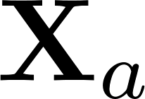
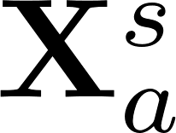
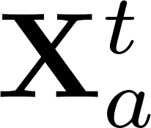
Traditionally, each training/testing sample has one type of feature.
feature extractor
training
testing

Slide 3
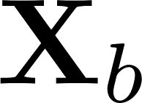
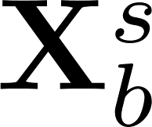
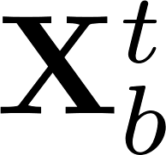
Actually, each training/testing sample could have multiple types of features.
ResNet feature
Inception feature
training
testing

Slide 4
Actually, each training/testing sample could have multiple types of features.
Luxury Yacht at the Miami International Boat Show 2012. Benetti Yachts sees 20% gain in new luxury yacht sales.
visual feature
textual feature
training
testing

Slide 5


Actually, each training/testing sample could have multiple types of features.
visual feature
audio feature
training
testing

Slide 6


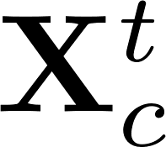
Actually, each training/testing sample could have multiple types of features.
Luxury Yacht at the Miami International Boat Show 2012. Benetti Yachts sees 20% gain in new luxury yacht sales.
ResNet feature
Inception feature
textual feature
training
testing

Slide 7
Single-view learning
Multi-view learning
Training feature
Training feature
….
Testing feature
Testing feature
….

Slide 8
Single-view learning
Multi-view learning
Training feature
Training feature
….
Testing feature
Testing feature
….

Slide 9
Multi-view Learning
Consensus principle
Complementary principle

Slide 10
Consensus Principle
The information among multiple views are consistent.
The information can include:
Feature
Decision value

Slide 11

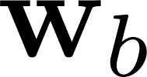
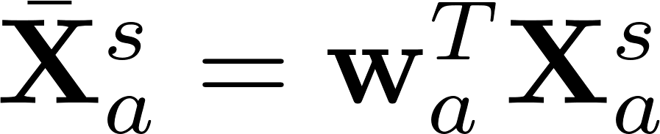
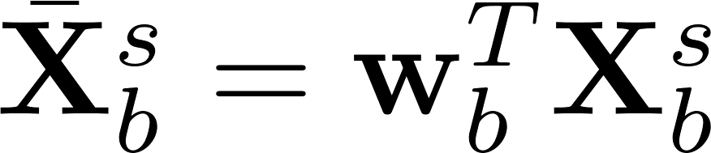
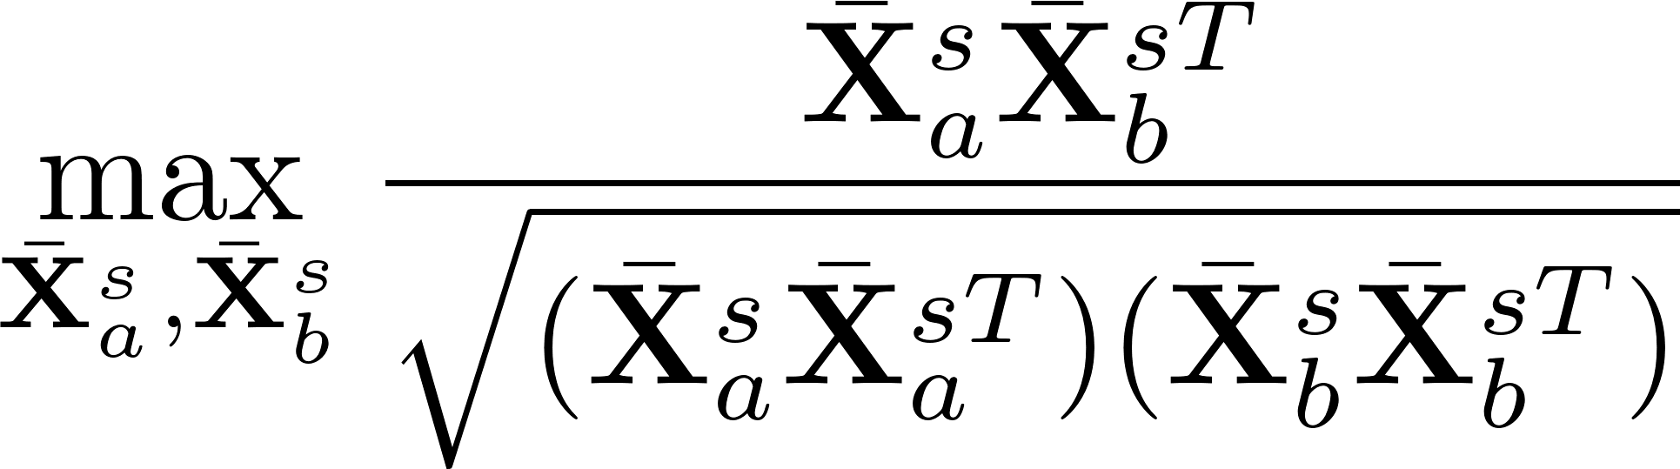
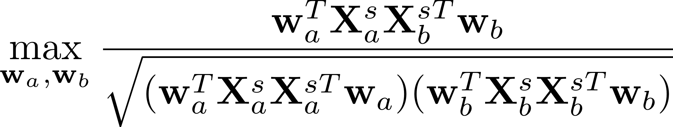
Canonical Correlation Analysis (CCA)
Given and ，
1. Decentralize and
2. Learn projection and to maximize the correlation between and

Slide 12
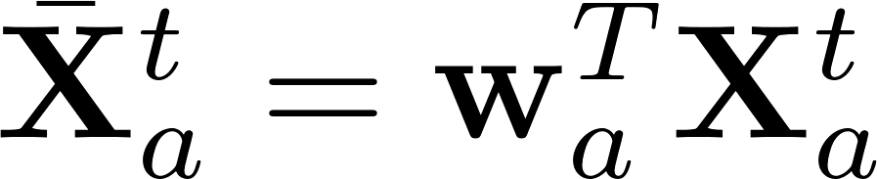
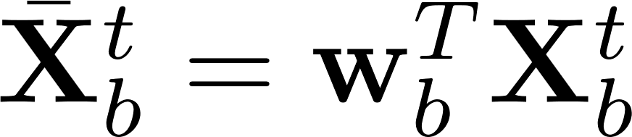
Canonical Correlation Analysis (CCA)
Training feature:
Testing feature:

Slide 13
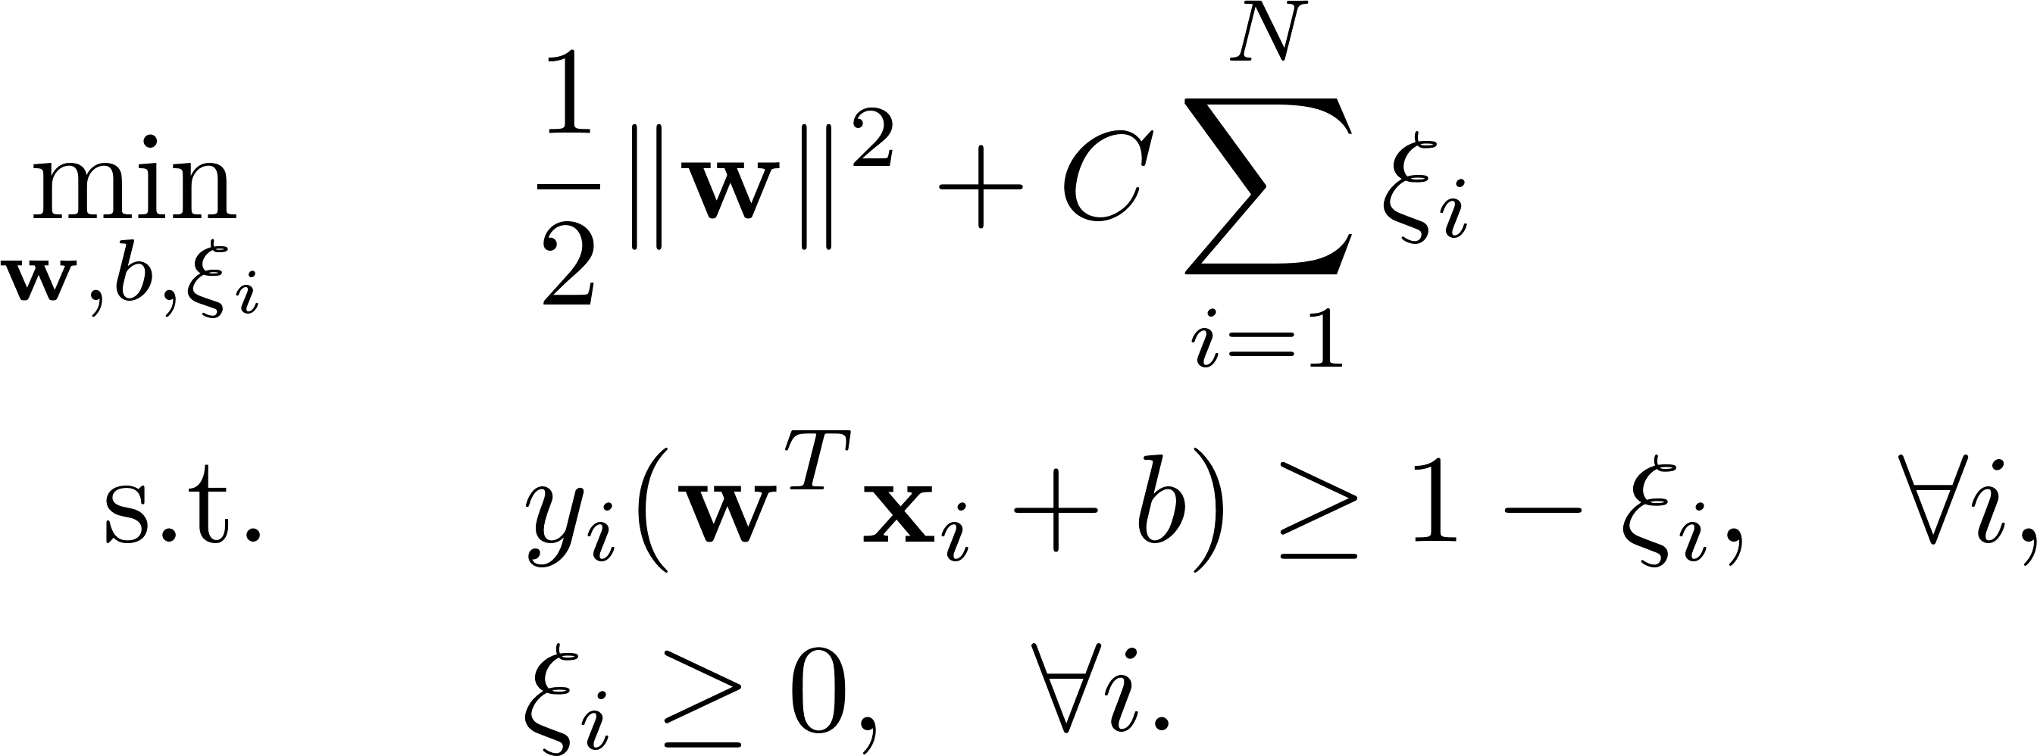
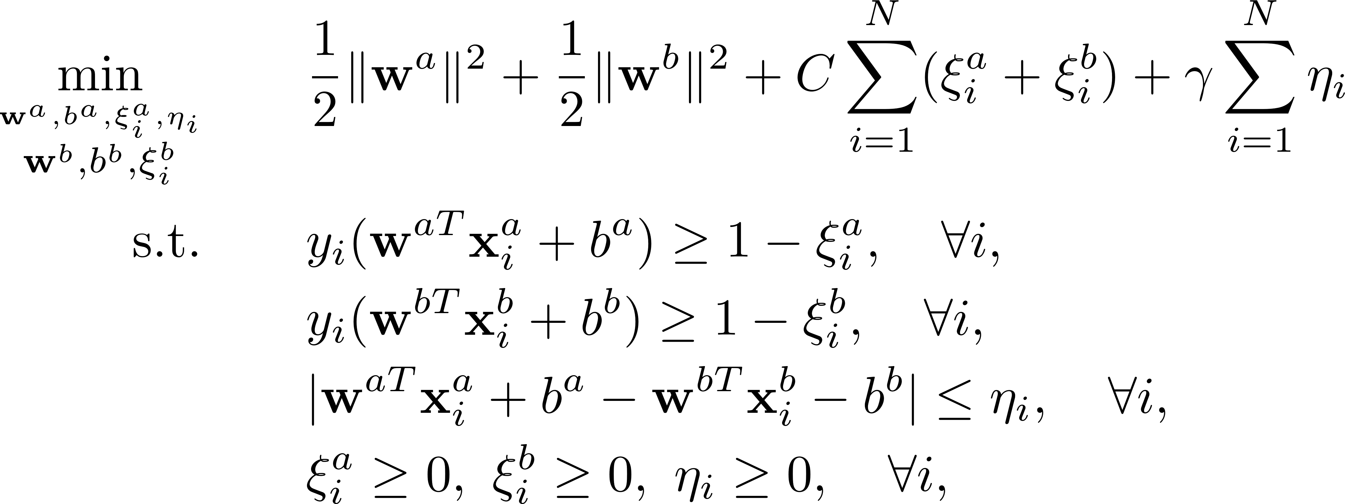
SVM-2K
SVM (single-view)
SVM-2K (double-view)
decision values on two views are consistent
Testing stage:

Slide 14
Multi-view Learning
Consensus principle
Complementary principle

Slide 15
Complementary Principle
The information among multiple views are complementary.
Early fusion: concatenate features
Late fusion: fuse decision values
View selection: assign different weights on different views

Slide 16
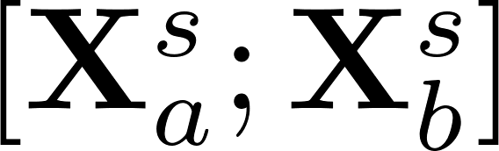
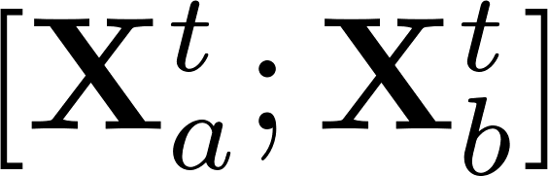
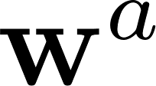

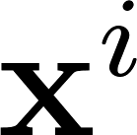
Complementary Principle
Early fusion: concatenate features
Late fusion: fuse decision values
Training feature
Testing feature
Train one classifier based on concatenated feature
Train two classifiers and based on features and
Given a test sample , the averaged decision value is

Slide 17
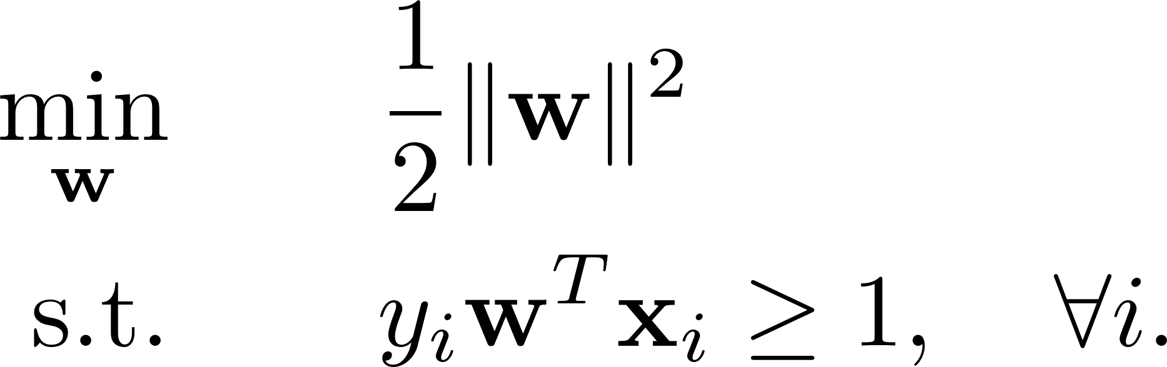
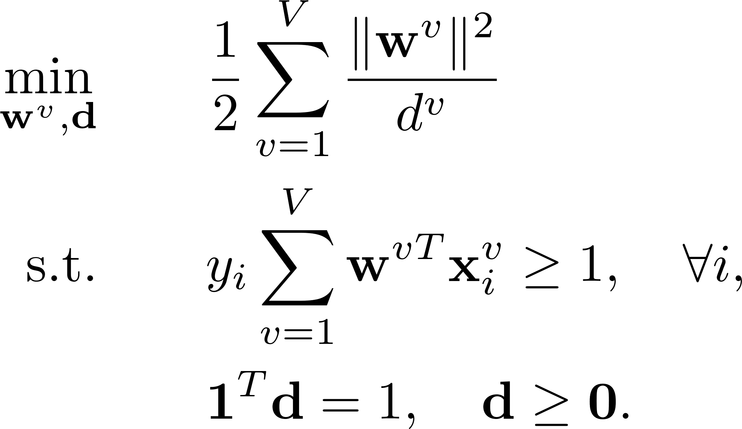
Multiple-Kernel Learning (MKL)
View selection: assign different weights on different views
SVM
assign different weights
on different views
MKL

Slide 18
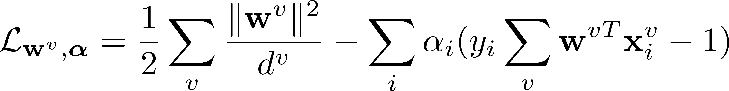
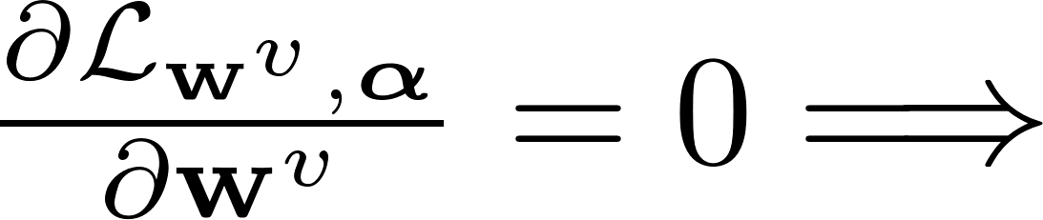
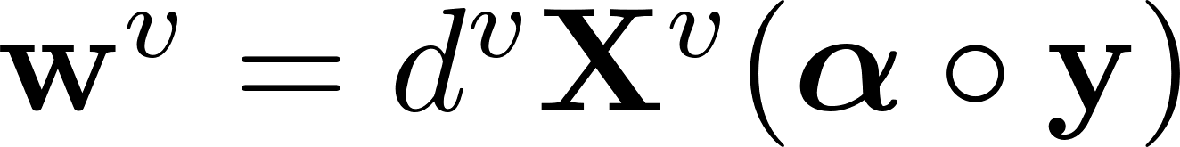
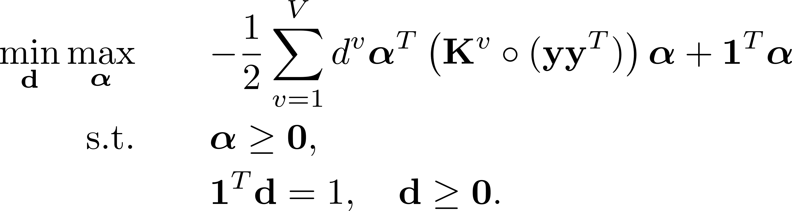
Multiple-Kernel Learning (MKL)
Primal form:
Dual form:

Slide 19
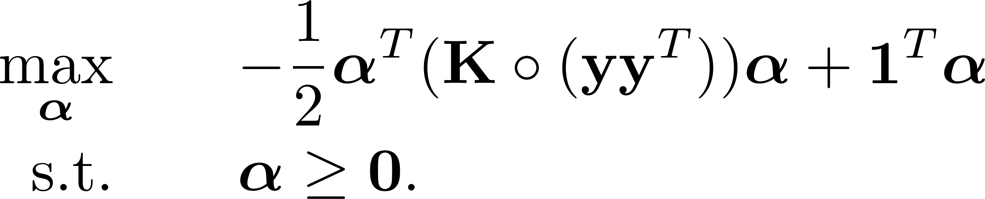
Multiple-Kernel Learning (MKL)
Dual form of MKL:
assign different weights
on different views
Dual form of SVM:

Slide 20


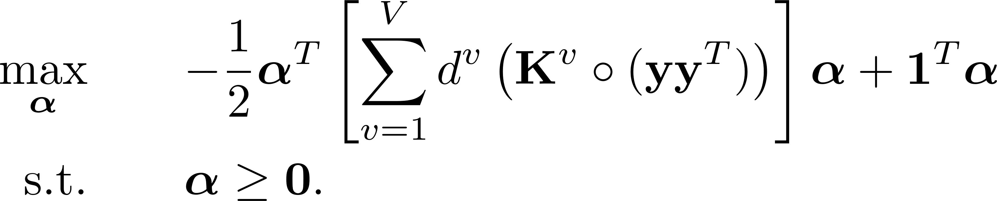
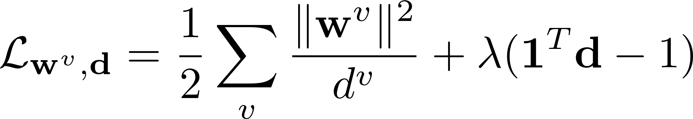
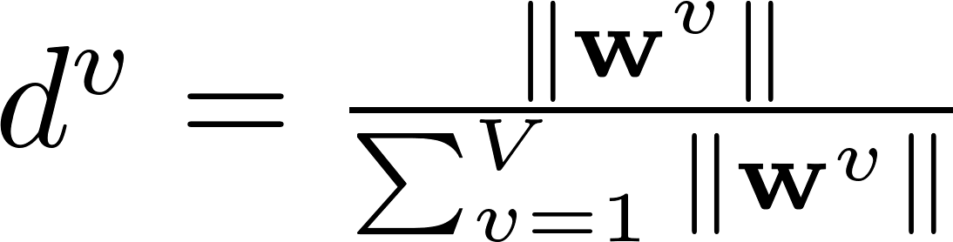
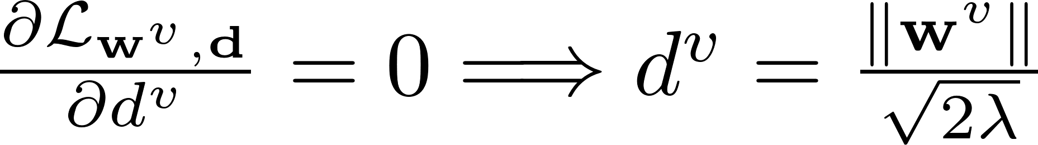
Multiple-Kernel Learning (MKL)
Solution: Update and alternatingly.
1. Update : Quadratic Programming (QP) problem
2. Update : close-form solution

Slide 21
Thanks!

